Slide 1
One Easy Habit to Help You Go Green: Reducing Personal-Vehicle Idling
Notes:
Thank introducer, hosting organization (if not yours), and audience.
_______________________________________________________
⃝ = Notes for presenter.
↘↘↘ = More detailed/background information for the presenter (may be of interest to some audiences or useful in response to some questions)
⃝ Presenter: This presentation is designed to be flexible. Slides may be added, deleted, or modified to accommodate variations in time allotted, anticipated audience interests, and/or local issues. At the presentation event, consider distributing some IdleBox materials:
Stickers: https://cleancities.energy.gov/files/images/idlebox_sticker.jpg
Bookmarks: https://cleancities.energy.gov/files/docs/template_idle_free_cards.doc
Fact cards/bookmarks: https://cleancities.energy.gov/files/pdfs/idle_free_cards.pdf
Tip sheets: https://cleancities.energy.gov/files/pdfs/idlebox_tip_sheet.pdf
Fact sheet “Which Is Greener: Idle, or Stop and Restart? Comparing Fuel Use and Emissions for Short Passenger-Car Stops”: https://anl.app.box.com/s/5xj5wp04p8vp5myhw7soodadr1kdooqr
Fact sheet (“Idling Is Not the Way To Go,” available at http://www.afdc.energy.gov/uploads/publication/light_duty_fs_6-2013_.pdf;
Stickers (https://www1.eere.energy.gov/cleancities/toolbox/images/idlebox_sticker.jpg).
Depending on your audience, you may want to have copies of the fact sheet, “Which Is Greener: Idle, or Stop and Restart? Comparing Fuel Use and Emissions for Short Passenger-Car Stops,” available at http://www.afdc.energy.gov/uploads/publication/which_is_greener.pdf.

Slide 2
[Add a slide about your coalition/organization as appropriate]
Notes:
Before I get into the nuts and bolts of the presentation, let me tell you briefly about [my organization].

Slide 3
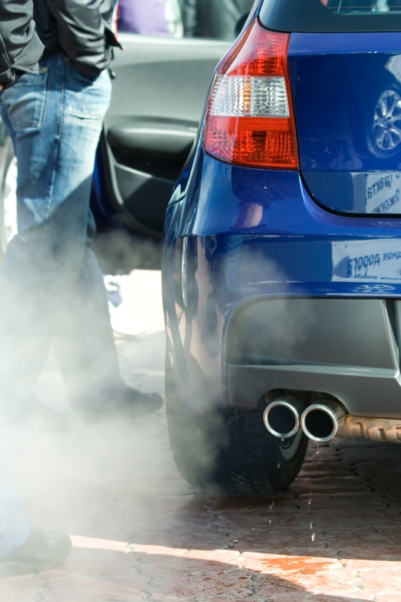
The Problem
Personal-vehicle idling generates about half of all idling emissions.
30 million tons of CO₂ annually.
More than 3 billion gallons of fuel at a cost of more than $10 billion each year.
Notes:
Here are some stunning big-picture facts about idling. In the U.S.:
Personal vehicle idling is the source of about half of all idling emissions.
Idling of personal vehicles generates about 30 million tons of CO₂ every year.
Thirty million tons of CO₂ is the equivalent of the total annual emissions for 6 million vehicles. Offsetting unnecessary idling would be like removing 6 million cars from the roads.
Passenger vehicle idling is estimated to waste more than 3 billion gallons of fuel annually. That’s enough to fill 4,500 Olympic swimming pools.
That’s the top-level view. On-the-ground, it’s money out of your wallet. Idling just six minutes a day adds up to more than 30 hours—or about 10 gallons—of 0 mpg vehicle use per year.
You may have heard of “energy vampires”—appliances that, while plugged in, pull power without serving any function. Idling is a type of energy vampire.
Shutterstock 4442143

Slide 4
Idling Reduction is the Low-Hanging Fruit of Fuel Economy
One Easy Habit to Help You “Go Green”
Notes:
Often when someone tells us about a way we can “go green,” we’re told that it’s going to cost money and/or time and maybe convenience.
Idling reduction for personal vehicles is not hard, expensive, or time-consuming. It’s easy, free, and something you can start doing immediately. In fact, if your vehicle is newer, it may be equipped with stop-start technology, which eliminates idling at stops.
Shutterstock 80756038

Slide 5
Why Do Drivers Idle? Habits and Myths
“Doesn’t restarting my engine use more gas than idling?”
“Won’t I wear out my starter?”
“Isn’t idling good for your engine?”
Notes:
Why do passenger car drivers idle? The answer is often simply, “habit.”
Idling to warm up a gasoline-fueled car is a habit formed long ago when vehicle technologies were less sophisticated and fuel cheap. Vehicles were sometimes hard to start and, especially, hard to restart if you overpumped the gas pedal and “flooded” your carburetor-equipped engine. Those of us who remember those days may feel uncomfortable turning our engines on and off frequently. We remember what it was like to worry that our engine wouldn’t restart.
Under normal use, passenger-car drivers can turn their engines on and off without concern about wearing out the starter motor or the battery prematurely.
Idling is not good for your engine. Modern cars actually warm up faster by being driven than by idling.
Shutterstock 21900871

Slide 6
Crossover Time: 10 Seconds
Idling for more than 10 seconds uses more fuel and results in the production of more CO₂ than does stopping and restarting your engine.
Notes:
Researchers at the Department of Energy’s Argonne National Laboratory determined in a small study that if you know you’ll be stopped for more than 10 seconds—and you’re not in traffic—you’ll save fuel and reduce CO₂ emissions by shutting off your engine and restarting when you need to move again.
The savings may not be exciting on a per-incident basis, but with hundreds of millions of drivers, the benefits add up.
↘↘↘ The study applied to passenger cars, not other vehicle types. The fact sheet is available at http://www.afdc.energy.gov/uploads/publication/which_is_greener.pdf.
Idling reduction is a very low-hanging fruit. It’s money in your pocket, and a contribution to cleaner air. No investment is required, and savings are immediate.
Shutterstock 54195328

Slide 7
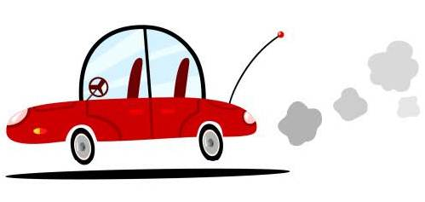
So, What’s the Big Deal about Idling?
1. Emissions impacts: health and environment
2. Use of nonrenewable resources
3. Cost
Notes:
The problems associated with idling fall into three general categories.
1. Emissions impacts: health and environment
2. Use of nonrenewable resources
3. Cost
Shutterstock 48952684

Slide 8
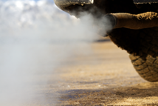
1. Emissions Impacts
Air quality and health and environment
Burned fuel results in the creation of carbon dioxide, a greenhouse gas.
Emissions contribute to the formation of pollutants that cause ozone and smog and reduce air quality. These can damage lungs and aggravate conditions like asthma.
Notes:
Emissions. The stuff that comes out of tailpipes is a lot cleaner than it used to be, but it’s still not something we want to breathe.
Idling increases the amount of harmful emissions a vehicle produces, including greenhouse gases like carbon dioxide—CO₂—that contribute to climate change.
↘↘↘ When fuel burns, the carbon and hydrogen react with oxygen to form water (H₂O) and CO₂.
Idling results in the production of smog, which threatens health. Smog, also called ground-level ozone, can damage lungs, and repeated exposure may cause permanent lung damage.
↘↘↘ Ground-level ozone (O₃) is a “secondary pollutant,” or byproduct of primary pollutants. It is created in the presence of sunlight. Motor vehicle emissions are major sources of ground-level ozone.
↘↘↘ The stratospheric ozone layer and ground-level ozone are, of course, two different things. (“Ozone good up high, bad nearby.” )
⃝ Presenter: If your region has “ozone action days” or “air quality alert days,” you may want to talk about these.
↘↘↘ More of ozone and health: http://www.epa.gov/groundlevelozone/health.html.
Shutterstock 68649247

Slide 9
1. Emissions Impacts, cont.
A word about air quality and children
Notes:
Do you sometimes see bus drivers and parents idling at schools? It’s important to remember that vehicle emissions are more concentrated at ground level where kids are walking and playing—and breathing.
Children breathe more air per pound of body weight than do adults. For this reason, they take in proportionately higher “doses” of any pollutants, which enter their lungs and, in some cases, bloodstream. Children are more biologically vulnerable.
Many jurisdictions limit or prohibit school-bus idling. Some jurisdictions prohibit the idling of any vehicle type near schools.
⃝ Presenter: To show a brief Clean Cities success story video, go to http://www.afdc.energy.gov/case/2. Instructions on how to download videos for both PCs and Macs are available at http://www.afdc.energy.gov/videos_help.html.
⃝ Presenter: Mention any idling laws that apply in your area. If you’re unsure of the laws, consult the idling law database, http://cleancities.energy.gov/idlebase.
↘↘↘ EPA’s Clean School Bus campaign (http://www.epa.gov/cleanschoolbus/antiidling.htm) is a resource for those interested in pursuing idling reduction for school buses at local schools.
For parents waiting in passenger cars, it’s simple. Turn off the engine.
Shutterstock 388630477

Slide 10
1. Emissions Impacts, cont.
Emissions impacts can be economic for regions that fail to comply with federal air quality standards
Notes:
Emissions have nonobvious impacts. Areas with high levels of air pollution may be in violation of the U.S. Environmental Agency’s National Ambient Air Quality Standards and can face steep fines. Such areas may also become ineligible for federally funded highway projects. These consequences can dampen a region’s prospects for economic development, making it less attractive to businesses.
⃝ Presenter: If your region has NAAQS compliance issues—especially for ozone—this would be a good place to mention that.
Shutterstock 54776782

Slide 11
2. Waste of Non-Renewable Oil
Notes:
Wasting oil reduces our energy security.
Shutterstock 31562014

Slide 12
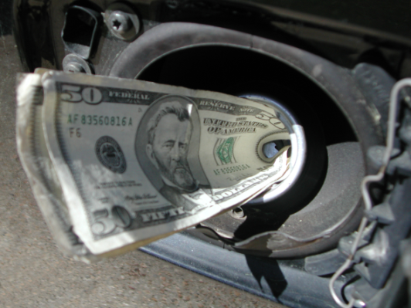
3. Cost: Who Wants to Buy 0-mpg Fuel?
If each car in the United States idles just 6 minutes per day, nearly 3 billion gallons of fuel are wasted annually, costing drivers more than $7 billion (when fuel is $2.50/gal).
Notes:
Here’s the big picture. If we each idle just 6 minutes a day—say, while waiting “just a few minutes” for our kids to wrap up soccer practice or while waiting to move forward in a drive-through pharmacy—we collectively waste about 3 billion gallons of fuel annually.
↘↘↘ 3 billion gallons of fuel at $2.50/gal = $7.5 billion
↘↘↘ For one passenger vehicle, this adds up to about about 36 hours of idling—nearly a full work week!—and about 10 gallons of 0-mpg fuel per year.
Shutterstock 248599

Slide 13
What Can I Do?
Commit to reducing idling
If you’re likely to be stopped for more than 10 seconds—and you aren’t in traffic—consider stopping and restarting. Opportunities include:
Waiting to pick someone up (e.g., school or work)
Drive-through transactions (e.g., pharmacies, banks, fast food, dry cleaners, Las Vegas weddings)
Railroad crossings and bridge lifts
Warm up your vehicle not by idling, but by driving with gentle acceleration.
Also: Limit the use of remote starters.
For your next vehicle, consider a vehicle equipped with stop-start technology or even an electric vehicle
Notes:
Think about the times you’re in your vehicle and not moving. If you’re waiting to pick someone up, do you really need to keep your engine running?
Waiting to conduct a drive-through businesses transaction, especially at banks and pharmacies where waits are always in the minutes, not seconds, are obvious choices for shutting the engine off. Shutting down the engine not only improves air quality for others in line but likely improves air quality for those working the drive-through windows.
Safety note: Idling is sometimes necessary for safety, such as in winter when windows need to be defrosted. (No one is suggesting sacrificing safety for the sake of idle reduction.)
Have teenagers? Teach them to avoid unnecessary idling as they learn to drive.
When purchasing or leasing your next vehicle, if you don’t choose an electric vehicle, consider choosing one with stop-start technology” (sometimes called idle-stop or microhybrid technology). For drivers who do a lot of stop-and-go driving, this technology can save a lot of fuel.
↘↘↘ Stop-start automatically shuts off the main engine at stops and seamlessly restarts it when the driver releases the brake.

Slide 14
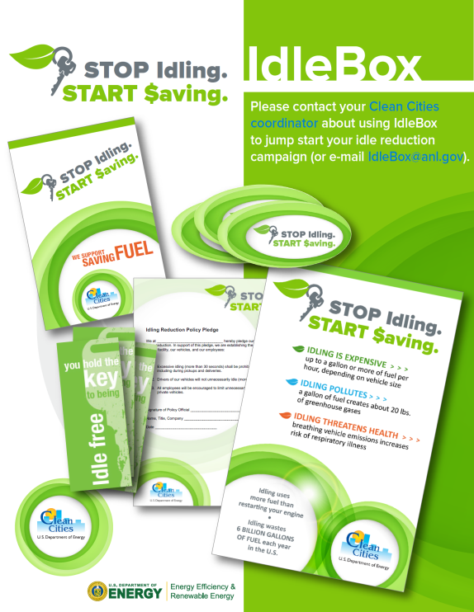
Other Resources
IdleBox
https://cleancities.energy.gov/technical-assistance/idlebox/
Alternative Fuels Data Center: Light-Duty Vehicle Idle Reduction Strategies
https://afdc.energy.gov/conserve/idle_reduction_light.html
fueleconomy.gov
https://fueleconomy.gov
Notes:
Here are some additional information resources.
IdleBox is a free, online resource created by the idle reduction team at Argonne National Laboratory for the U.S. Department of Energy’s Clean Cities initiative. Use IdleBox not only to learn more about idle reduction but also to find tools to help launch an idle reduction campaign in your community.
You can find IdleBox quickly by Googling “IdleBox” or by going to the web address shown on the slide.
The Alternative Fuels Data Center page shown on the slide and fueleconomy.gov are other valuable resources.

Slide 15
One Easy Habit to Help You Go Green: Reducing Personal-Vehicle Idling
Thank You
Notes:
This wraps up my presentation. Reducing idling is a very low-hanging fruit. It’s money in your pocket with no investment required. Savings are immediate, and you help improve air quality.
I’m happy to take any questions you may have.
⃝ Presenter: Mention any fact sheets, bookmarks, stickers, or other information giveaways you have.

