Slide 1
Idle Reduction for Long-Haul, Heavy-Duty Trucks
Notes:
Thank introducer, hosting organization (if not yours), and audience.
⃝ = Notes for presenter.
↘↘↘ = More detailed/background information for the presenter (may be of interest to some audiences or useful in response to some questions).
_______________________________________________________
⃝ Presenter: This presentation is designed to be flexible. You may choose to place your organization’s logo in the bubble to the upper right of the Clean Cities logo. Slides may be added, deleted, or modified to accommodate variations in time allotted, anticipated audience interests, and/or local interests. At the presentation event, consider distributing IdleBox materials such as:
Long-Haul Idling Burns Up Profits fact sheet (https://afdc.energy.gov/files/u/publication/hdv_idling_2015.pdf)
Economics of Idling Reduction Options for Long-Haul Trucks fact sheet (https://cleancities.energy.gov/files/pdfs/EconomicsLongHaulTrucks_fs_FINAL.pdf)
The idling savings calculator (https://www.anl.gov/es/reference/vehicle-idle-reduction-savings-worksheet-pdf)
The tip sheet (https://cleancities.energy.gov/files/pdfs/idlebox_tip_sheet.pdf)
Stickers (downloaded and printed from https://cleancities.energy.gov/files/images/idlebox_sticker.jpg or ordered from NREL for Clean Cities coordinators)

Slide 2
[Add a slide about your coalition/organization as appropriate]
Text and image(s)
Notes:
Before I get into the nuts and bolts of the presentation, let me tell you briefly about [my organization].

Slide 3
Idle Reduction for Long-Haul, Heavy-Duty Trucks
Why Do Heavy-Duty Trucks Idle?
What Are the Costs and Consequences of Idling?
Technologies To Support Idle Reduction
Resources
Notes:
In this presentation, I’ll cover:
The reasons heavy-duty trucks idle
The costs and consequences of idling
Technologies to support idle reduction in long-haul, heavy-duty trucks
And resources to help you evaluate the potential of idle reduction for your trucks and resources to help you implement it.
Shutterstock 28033639

Slide 4
Why Do Heavy-Duty Trucks Idle?
To heat and cool the cab and sleeper
To keep the fuel warm in the winter (to avoid cold starts)
To keep the engine and cab warm while waiting in lines and making pick-ups and deliveries
Notes:
As you likely know, long-haul truck drivers spend a lot of time on the road performing a vitally important service—moving freight. These drivers don’t return home every night; when on the road, they “hotel” in their truck’s sleeper berth.
Truck drivers also sometime idle to keep the engine and fuel warm in winter and often idle while waiting in lines and making pick-ups and deliveries.
↘↘↘ Even if the drivers were superhuman, the Federal Motor Carrier Safety Administration’s (FMCSA) “Hours of Service” rule requires that truck drivers take rest periods for safety reasons. During these rest periods, most drivers rest in their sleeper berths, where they need climate control and power for electronics and other necessities. A summary of FMCSA’s Hours of Service rule is available at fmcsa.dot.gov/regulations/hours-service/summary-hours-service-regulations.
↘↘↘ The HOS rule also requires that after driving 60/70 hours over 7/8 consecutive days, a driver must take off at least 34 hours. If this “34-hour restart period” is taken in the truck, that’s potentially 34 idling hours.
Shutterstock 5034154

Slide 5
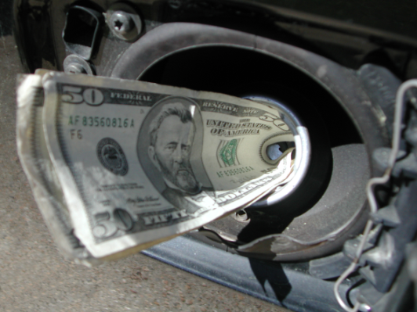
What Are the Costs and Consequences of Idling?
Idling Is Expensive
A truck idling 1,800 hours/year for overnight “hotel load” alone will consume about 1,440 gallons of fuel per year.
Annual cost:
$3,600 at $2.50/gal
$4,320 at $3.00/gal
$5,040 at $3.50/gal
$5,760 at $4.00/gal
Notes:
So, how much fuel do these idling trucks burn?
A long-haul, heavy-duty truck typically consumes about 0.8 gallon of fuel/hour while idling.
The slide shows the annual cost for rest-period idling according to fuel price. As you can see, regardless of fuel price, idling burns up thousands of dollars in 0-mpg fuel every year for every truck.
Shutterstock 248599

Slide 6
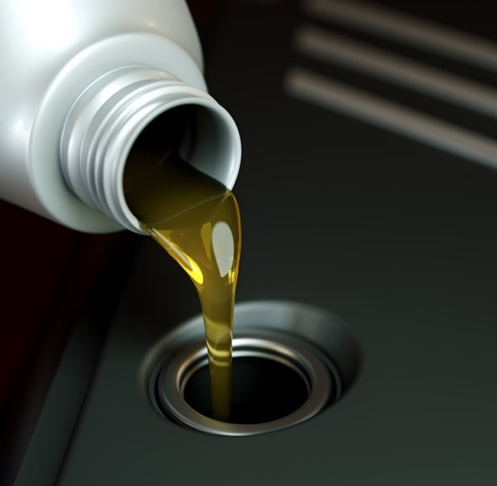
What Are the Costs and Consequences of Idling?
Idling Increases Engine Wear
Engine operation = engine wear
More frequent maintenance
Idling is especially hard on diesel particulate filters (DPFs)—filters get dirty, and they cannot be regenerated (cleaned) during engine idling
Reduced time to engine overhaul
Notes:
For trucks, maintenance intervals for oil, fuel filters, air filters, and emission-control technologies like diesel particulate filters are usually set by “hours of operation” rather than “miles driven.” Idling is, of course, engine operation. You may have heard the term ghost miles, which is a term some use to describe how idling for X minutes is equivalent to driving Y miles. There is no magic number for this—the value for so-called ghost miles will vary by vehicle and engine type and engine load at idle—but the takeaway remains the same: idling is engine operation, which results in more-frequent maintenance and engine wear.
Shutterstock 152769011

Slide 7
What Are the Costs and Consequences of Idling?
Idling Pollutes
According to Argonne National Laboratory, rest-period truck idling consumes about 1 billion gallons of diesel fuel each year, emitting:
10 million tons of carbon dioxide (CO₂)
55,000 tons of nitrogen oxides (NOx)
400 tons of particulate matter (PM)
Notes:
Pollution is another consequence of idling. Argonne National Laboratory estimates that rest-period idling contributes to the formation of 10 million tons of carbon dioxide, 55,000 tons of nitrogen oxides (or NOx), and 400 tons of particulate matter (PM) annually.
These values assume a mix of older and newer trucks. Older truck engines are more polluting than newer engines; newer engines have better emission controls.
↘↘↘ Newer trucks have very low PM emissions.
Shutterstock 1080043415

Slide 8
What Are the Costs and Consequences of Idling?
Idling May Be Illegal
Notes:
A number of states and municipalities regulate engine idling, especially for heavy-duty diesel trucks. The map shows states that have statewide restrictions in orange; you can see that they’re concentrated on the coasts. Idling laws can be statewide, countywide, municipality-wide, or extremely local. States that have idling laws only at the county or municipal level are shown in blue. States with no known idling restrictions are shown in gray.
↘↘↘ Some individual municipalities in “Orange states” may also have idling ordinances that are more-restrictive than the state law.
↘↘↘ North Carolina had an idling law but lawmakers repealed it in fall 2015. Florida’s idling law was repealed in 2011.

Slide 9
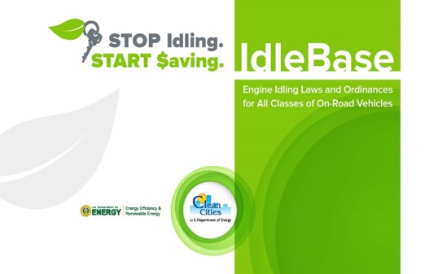
What Are the Costs and Consequences of Idling?
Idling May Be Illegal
California: 5-minute limit
Fines: $300 to $10,000
New York: 5-minute limit
$500 to $18,000 for a first violation
Many others, including—Connecticut, Washington DC, Maryland, Massachusetts, Pennsylvania, Oregon, Vermont, and Virginia
http://cleancities.energy.gov/idlebase
Notes:
⃝ Presenter: Consult IdleBase to tailor, if desired, this slide for local or regional restrictions.
As you can see, some states, such as California and New York, have strict idling limits with steep fines.
Enforcement of idling laws may be patchy, but penalties for violations can be steep.
Clean Cities’ IdleBase describes idling laws for all classes of on-road vehicles. For a compilation of laws specific to heavy-duty trucks only, the American Transportation Research Institute (atri-online.org) provides a downloadable cab card.
↘↘↘ ATRI cab card at https://truckingresearch.org/2020/03/16/idling-regulations-compendium/

Slide 10
Technology to Support Idle Reduction
Auxiliary power units (APUs)
Heaters
Air conditioners
Engine idle management systems
Electrified parking spaces
Complementary technologies
Notes:
So, let’s talk about idling solutions. Long-haul, heavy-duty trucks are a clear case where drivers have a real, extended need for engine-off power. Telling these drivers to “just turn it off” during rest periods is not a workable solution.
Fortunately, there are technology solutions that can eliminate or sharply reduce idling.
The available technologies are:
Auxiliary power units (APUs)
Heaters
Air conditioners
Engine idle management systems
Electrified parking spaces
Complementary technologies
I’ll describe each of these in a bit more detail in the following slides.

Slide 11
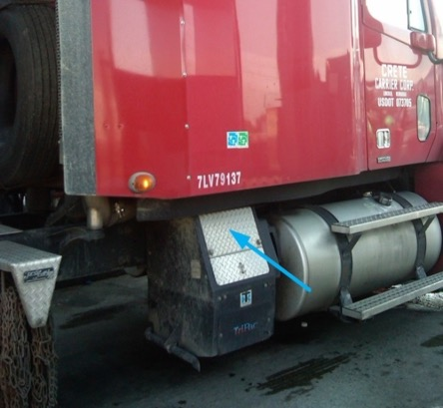
Technology to Support Idle Reduction
Auxiliary Power Units (APUs) provide full service
Auxiliary power is provided for heat, A/C, electronics, and other devices
May be powered by fuel or battery; may be wayside-power compatible
No federal excise tax for EPA-verified technologies, and most states have APU weight exemptions so truckers are not penalized for the extra weight
Photo courtesy of Terry Levinson
Notes:
Auxiliary power units are vehicle-mounted systems (either from the original equipment manufacturer or purchased aftermarket) that provide engine-off power for climate control, electronics, and devices such as microwaves.
While these systems are often powered by diesel fuel, some run on electricity or alternative fuels. Sometimes solar power is used to supplement other power sources.
↘↘↘ There are also APUs powered or supplemented by other means, such as fuel cells or solar power.
Some APUs can be plugged in to run on standby electric power—also called “truck stop electrification” or “shore power.”
EPA-verified devices are exempt from the federal excise tax. Additionally, most states—with a few exceptions, including California—exempt the weight of approved idle reduction devices on heavy-duty trucks.
⃝ Presenter: Information about the federal excise tax exemption for idle reduction devices is available at https://www.epa.gov/verified-diesel-tech/learn-about-federal-excise-tax-exemption

Slide 12
Technology to Support Idle Reduction
Most states have weight exemptions for APUs
The weight exemption applies to the U.S. EPA’s Verified Idle Reduction Technologies.
Notes:
Most states have weight exemptions for APUs; this means that APUs won’t count against truck weight limits. This map shows states that have 550-lb and 400-lb weight limits. Sometimes states permit the extra 400 lbs by enforcement policy, not by law.
“APU exemption” is a bit of a misnomer; for most states, qualifying technologies include heaters, air conditioners, and other devices that limit idling.
For equipment to be exempt, it must be on the U.S. EPA’s Verified Idle Reduction Technologies list (hyperlink on slide).
↘↘↘ Auxiliary Power Weight Exemption to GVW Limit: 23 CFR 658.17(n)
https://www.govinfo.gov/content/pkg/CFR-2007-title23-vol1/pdf/CFR-2007-title23-vol1-sec658-17.pdf

Slide 13
Technology to Support Idle Reduction
Heaters
Provide warmth to the cab/sleeper using less than 10% of the fuel used in engine idling
Air heaters supply warm air to the cab/sleeper
Coolant heaters heat the vehicle’s coolant, which, when circulated through the vehicle’s heat system, provides some cab heat
Notes:
Now for some of the more focused-service solutions. Again, these solutions are sometimes the most cost-effective, either by themselves or paired with another specific-service solution when full service isn’t needed.
Truck drivers who need heat for the cab or sleeper may consider air heaters, which are usually diesel-fired. However, the heaters use less than 10% of the fuel consumed by an idling engine. An engine block heater to eliminate diesel "warm up" idling may also be installed.
Coolant heaters heat the vehicle’s coolant, which is circulated through the regular heat-transfer system. Coolant heaters keep the engine warm, reducing the impact of cold starts, and may provide some cab heat. While they may a good option for “day cab” use, they would not be a good option for a driver needing heat over a 10-hour rest period.
If heat is the only “hotel need” during a rest period, a heater will be more cost-effective than an APU. Because heaters use so little fuel, some drivers who have APUs actually run a separate heater when they need only heat.
Some heaters are “shore-power compatible” so can be powered by electricity if an electrical pedestal is available at the truck stop.

Slide 14
Technology to Support Idle Reduction
Air Conditioners
Provide engine-off air conditioning powered by energy stored when the truck is running
Increase operational fuel use by only a small amount
May be shore-power (plug-in) compatible
Evaporative coolers are an option for hot, dry climates
Notes:
Battery-electric air conditioners for trucks use the running engine’s energy to charge the battery. These devices do increase the engine’s operational fuel consumption, but only by a small amount.
↘↘↘ The emissions from burning this fuel are controlled by the engine's emissions control system and occur on the highway rather than at the truck stop or depot.
Many air conditioning options are plug-in capable so can be used at truck stops where grid-power pedestals are available.
Another option, for hot, dry climates only, is an evaporative cooler. These devices cool the air through the evaporation of water.
↘↘↘ A concern with battery-electric air conditioners is duration of service; if a truck will need A/C for more than 8-10 hours, such as over a 34-hour restart period, the unit will need to be recharged by idling the engine for a number of hours unless the device is standby-power compatible and there’s a place to plug in.

Slide 15
Technology to Support Idle Reduction
Engine idle-management systems
Idle timer
Turns engine off after a preset amount of idle time
Automatic engine shut-down/start-up system
Turns engine off and restarts it based on cabin temperature and/or battery-charge level
Notes:
Here’s another technology type that supports idle reduction. Engine idle management systems reduce—but do not eliminate—idling time.
Some heavy-duty trucks are equipped with idle timers. These simply turn the engine off after the truck has been stationary (and in Park) for a preset amount of time. Idle timers help reduce idling at shorter stops, but they are not a solution for reducing overnight idling where engine-off power is needed.
Automatic engine shut-down/start-up systems take idle limiters to the next level. With the use of temperature sensors, they turn the engine on and off intermittently to keep the cab/sleeper within a certain temperature range. One downside is that the noise associated with an engine turning on and off intermittently may disturb truckers’ sleep. Also, in extreme temperatures, fuel savings may be minimal.

Slide 16
Technology to Support Idle Reduction
Electrified Parking Spaces (EPS)
EPS—also called truck-stop electrification (TSE) or shore power—provides off-board power and/or services
Single system: Provides drivers with warm or cooled air vis a flexible air duct that attaches securely to a window. Electrical outlets, and sometimes internet access and TV, are also available.
Dual-system: Provides drivers with power so that plug-in capable, on-board APUs/HVAC systems can run on electricity. 460-volt power for transport refrigeration units may also be available. (“Dual system” because both on-board and off-board equipment are required.)
EPS is not widely available.
Notes:
Electrified parking spaces—sometimes called truck stop electrification, shore power, wayside power, or electric standby—provide off-board power, and sometimes equipment, for engine-off heating, cooling, and other truck driver necessities.
Single-system EPS technology provides HVAC directly to the truck via a gantry- or pedestal-mounted duct. These installations, located at truck stops or truck terminals, may also provide electricity and amenities such as internet access. This is called “single system” because no special on-board equipment is needed.
↘↘↘ While single-system EPS is a particularly cost-effective option for the provision of air conditioning, its availability is limited. Single-system EPS systems have been installed successfully at several truck terminals.
With dual-system EPS, a truck driver plugs in his or her APU, heater, and/or other devices to an electricity pedestal. This is called “dual-system” because trucks must be equipped with equipment that’s shore-power compatible.
⃝ Presenter. IdleAir is currently the only active provider of single-system TSE. Before presenting, you may want to check IdleAir’s website (idleair.com) for recent news or updated offerings. Shorepower is currently the most-active provider of dual-system TSE. Before presenting, you may want to check Shorepower’s website (shorepower.com) for recent news or updated offerings.
↘↘↘ Electrified parking spaces produce no local emissions, although there are upstream emissions from electricity generation and the production and transport of power-plant fuel. The source of the electricity generated (e.g., hydropower, nuclear, or coal) will determine the overall emissions picture.

Slide 17
Complementary Technologies
Telematics Systems
Provide data about vehicle location and engine status, including idling episodes
Data allow managers to identify idling patterns (and “high idlers”) and determine which solutions make the most sense
Cab insulation, window glazing, reflective paint, and passive measures
Can reduce a stationary vehicle’s energy requirements, allowing the use of smaller, lighter, and less-expensive idle reduction equipment (with faster ROI)
Notes:
Finally, here are some technologies that complement the primary idle reduction technologies.
Telematics systems, which have become widely available and are rapidly growing in sophistication, can play a key role in idle reduction. While telematics systems do not themselves reduce idling or provide power for engine-off services, they can provide data on unnecessary or prolonged idling and other behaviors that reduce fuel economy. Many fleets have reported surprisingly high idling-time percentages; these data allow them to devise ways to tackle idling fuel losses.
Other approaches, such as the use of cab insulation, window glazing, and reflective paint, may reduce a stationary vehicle’s energy requirements. Doing so may allow the use of smaller, lighter, and less-expensive idle reduction equipment. Passive measures, such as parking in the shade in summer or facing south in winter, will also reduce power needs.
⃝ Presenter: The DOE/VTO fact sheet, “CoolCab: Reducing Thermal Loads in Long-Haul Trucks,” addresses the use of sleeper-cab curtains, standard window shades, and insulated windows in long-haul trucks. It’s available at afdc.energy.gov/pdfs/47415.pdf.

Slide 18
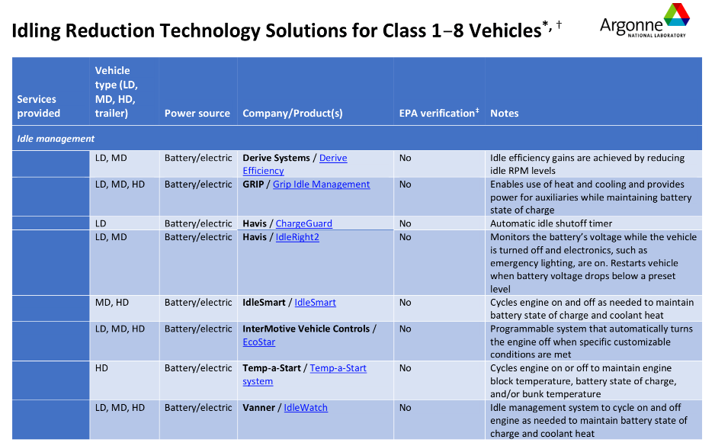
Resource: Idle Reduction Equipment Table
Organized by service(s) needed:
Idle management
Heat only
Cooling only
Heat, cooling, and power (auxiliary power unit)
Power take-off
Cargo refrigeration
Wayside power / truck stop electrification
https://www.anl.gov/es/reference/idling-reduction-technology-solutions-for-class-18-vehicles
Notes:
I’m now going to introduce you to some valuable resources. Idling Reduction Technology Solutions for Class 1-8 Vehicles is a table of about 45 idle reduction technologies with basic information and direct links to the manufacturer pages.
It is organized by stationary services needed (such as heat, cooling, or both with the addition of power) along with vehicle size. Look for solutions identified as HD for heavy duty.
⃝ Presenter: If you brought copies, mention that attendees can pick up a copy after the session.

Slide 19
Resource for Estimating Your Payback
https://www.anl.gov/es/reference/vehicle-idle-reduction-savings-worksheet-pdf
Notes:
The cost-effectiveness of any idle reduction approach or technology depends on the amount of idling to be offset, which depends in part on the climate where the vehicle is operated.
Argonne National Laboratory provides this calculator that allows fleet managers, owner-operators, and others to determine how much money they can save with idle reduction.
Depending on the technology chosen, current fuel prices, and how much a truck idles, the payback for idle reduction technology use may be months or years. There’s a lot of variability.
⃝ Presenter: If you brought copies, mention that attendees can pick up a copy after the session.

Slide 20
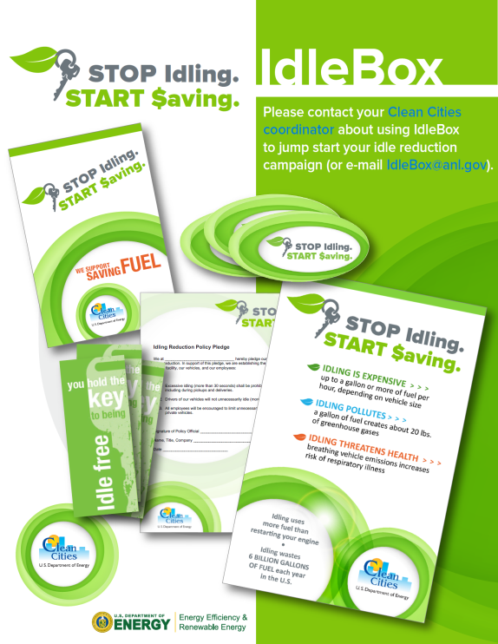
Resource: IdleBox
Idle reduction cost savings calculator
Table of technology solutions with manufacturer links
IdleBase: A database of idling regulations
Fact sheets, signage, poster templates, and more
https://cleancities.energy.gov/technical-assistance/idlebox/
Notes:
If you’re wondering where you can find these tools, go to IdleBox. IdleBox is a free, online resource developed by the idle reduction team at Argonne National Laboratory for U.S. DOE’s Clean Cities initiative
You can find IdleBox quickly by Googling “IdleBox.”

Slide 21
Resource: Funding Opportunities
State grant programs
EPA’s State Clean Diesel Grant Program
National grant programs
EPA’s Diesel Emissions Reduction Program (DERA)
U.S. Department of Transportation’s Congestion Mitigation and Air Quality (CMAQ) Improvement Program
VW Settlement funds (Eligible Mitigation Option 10, DERA)
Programs targeted to supporting small businesses, sustainability initiatives, etc.
Notes:
Finally, here are some resources for potential funding assistance.
The U.S. EPA’s Clean Diesel Program provides financial support for some idle reduction projects. Proposed equipment must be from the EPA’s list of Verified Idle Reduction Technologies. For California, equipment must be California Air Resource Board (CARB) approved.
The U.S. DOT’s CMAQ program has provided funds to states for diesel retrofit projects.
Funds from the Volkswagen Clean Air Act Civil Settlement’s Mitigation Trust are being made available to states for the reduction of nitrogen oxide (NOx) emissions. Some idle reduction projects qualify under Eligible Mitigation Option 10.
Finally, there are organizations that have programs and funding to support small businesses, clean air initiatives, etc.

Slide 22
Idle Reduction for Long-Haul,
Heavy Duty Trucks
Thank You
Notes:
This wraps up my presentation. I’m happy to answer any questions you may have.

